Slide 1
Instacart
Group #10
Abdulaziz Alajaji, Fangling Zhang, Kavin Chandrasekaran, Sishi Hao

Slide 2
Outline
Introduction
The Proposed Business Intelligence Solution
Dashboard
Next Order prediction and Implementation
Summary and Conclusion

Slide 3
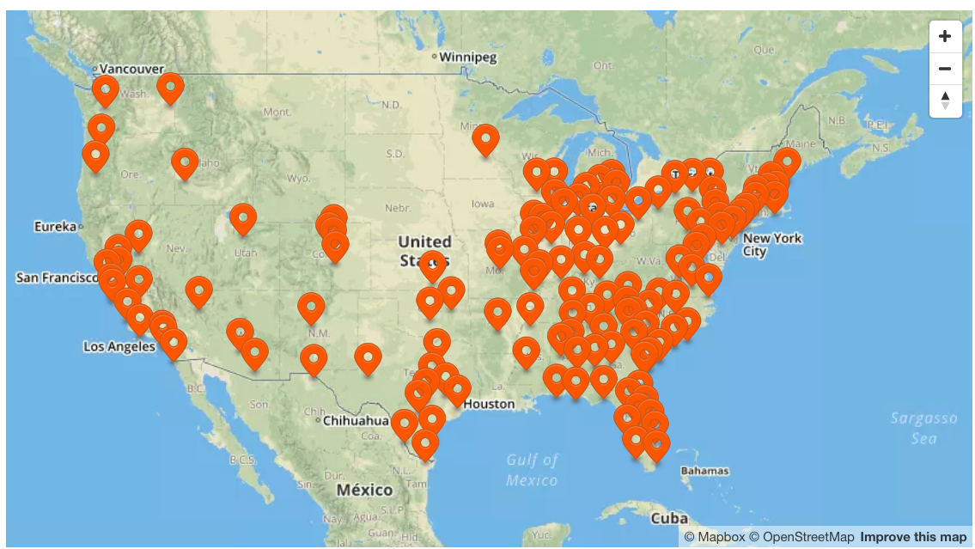

Introduction
Shared-Economy Based Startup, Founded in 2012
Mobile and web based, on-demand same-day grocery delivery service
HQ: San Francisco, CA

Slide 4
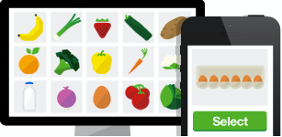


How it works
Step 1
Step 2
Step 3
Select groceries from 500,000 items at stores.
Instacart routes the order to a vetted Personal Shopper who collects items.
The order is delivered in as little as 2 hours.

Slide 5









Current Status
Mobile
Web
Server
Cloud Apps
Segment Platform
Email
Analytics
Helpdesk
Data Warehouses
Notes:
Collect real-time data across website, mobile apps on Android and iOS
Pull in data across outside touchpoints like email to get a complete picture of the shopper and customer experience.
Embed data scientists into product teams, side-by-side with engineers, designers and product managers
Data scientists report into the engineering leader for the product team.

Slide 6
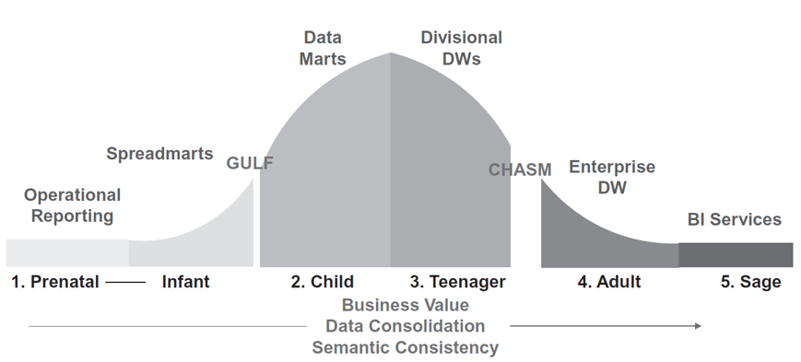
Current Status
Migrating from departmental and divisional BI to an integrated enterprise-wide BI program

Slide 7
Current Problems
Delivery Time & Shopper Performances
Resources Arrangement
Products Recommendation
Notes:
Products recommendation: With strong competitors like Amazon Fresh, Shipt, Instacart need to recommendate products to customers more accurately and timely
Reduce Delivery time: Delivering groceries within 2 hours is still a challenge for Instacart.
Out of stock items: Sometimes, Items in the shopping list go out of stock.
Separate product teams management: many product teams, each of which have software engineering, analysts, product managers and engineering leaders dedicated to them. Some teams are only 3 people, others are up to 10. It is hard to manage these separate teams

Slide 8
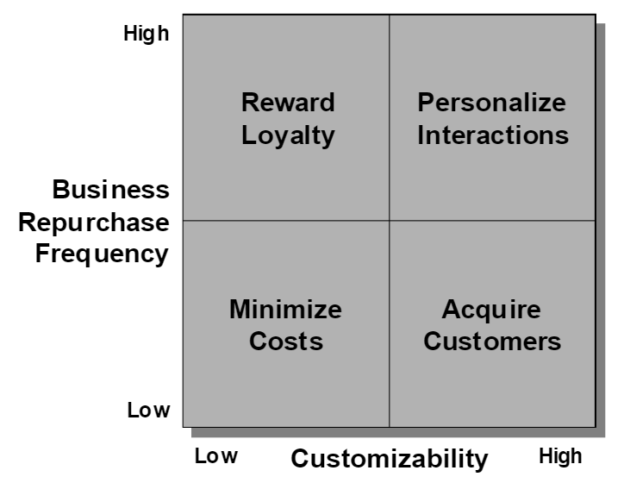
Strategy
Four-strategies Framework for Exploiting Customer Data

Slide 9
Our client
Regional Manager: a tactical dashboard
Shopper Manager: a tactical dashboard
Marketing manager: a recommendation system and operational dashboard

Slide 10
Proposed BI Solution
Resources Arrangement: regional management dashboard, Most profitable customers and most popular products, arrange more resources (eg. staff, reward)
Delivery Time & Shopper Performances: delivery time management dashboard, control slowest delivery Moment, Share peak order time with Shoppers, reward fastest shoppers.
Products Recommendation: predict products in next order for each customer, personalize product recommendation and promotion

Slide 11
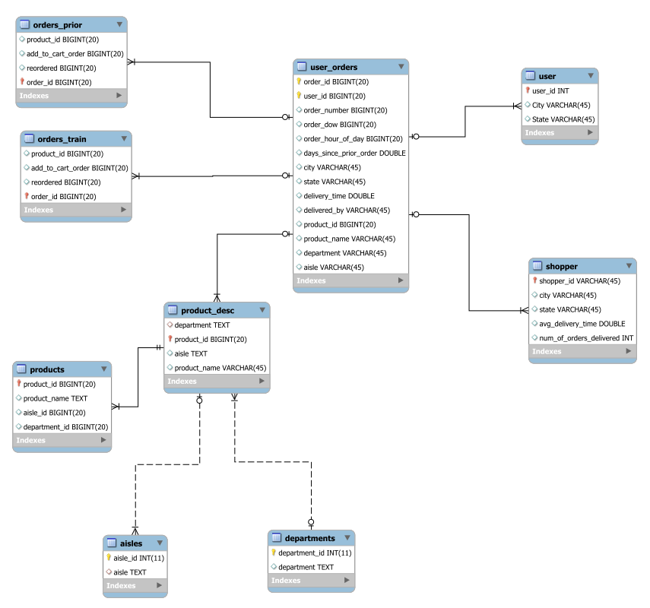
Star Schema

Slide 12
Dataset modification for Dashboards
Synthetic:
Delivery times
Location: State, City
Calculated, with some assumptions:
Date:
There is one order for each customer meant to be a target for prediction
We assume that this order is the latest order, and then assign dates to orders starting from last going backwards given that each order has column “day of order”.
Will show how our proposed solution can be useful if real data is present.
Notes:
The dataset contains orders for several customers

Slide 13
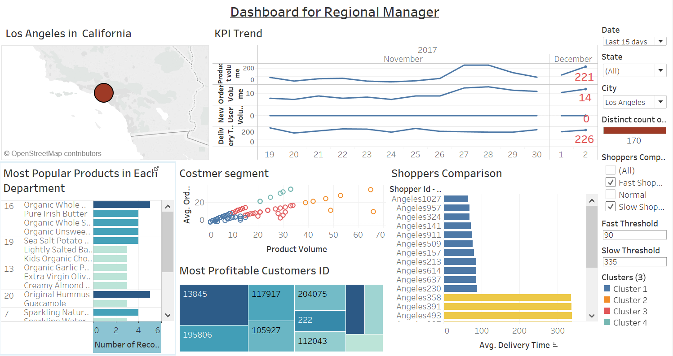
Tactical Dashboard for Regional Manager

Slide 14
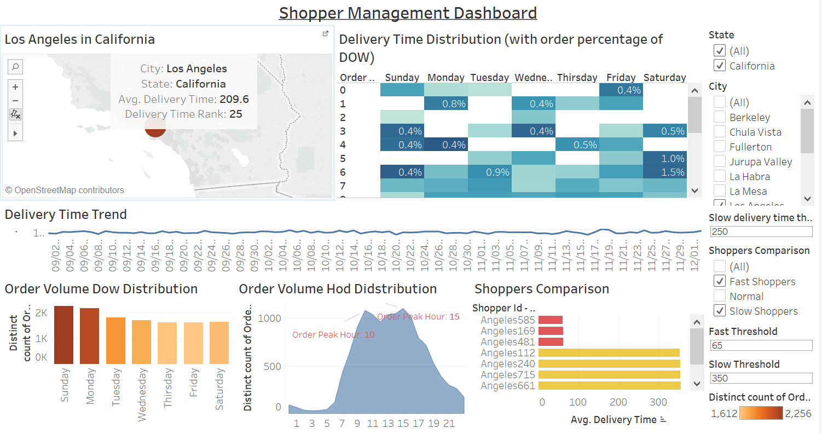
Tactical Dashboard for Shopper Manager

Slide 15
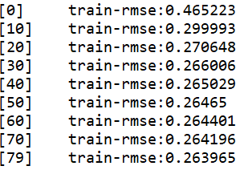
Forecasting
XGBoost model
Training loss:
Accuracy:

Slide 16
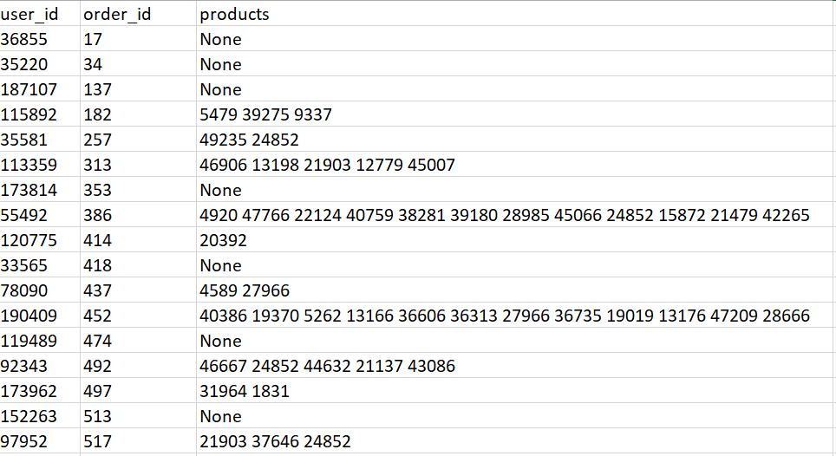
Forecasting
Classification --
XGBoost model
Products prediction
in next order

Slide 17
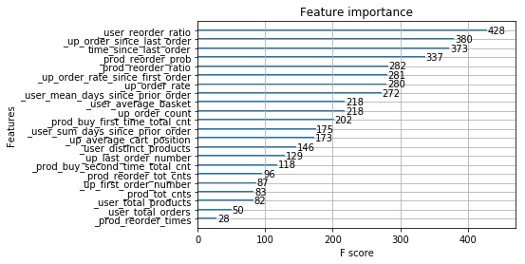
Forecasting
XGBoost model --Feature importance:

Slide 18
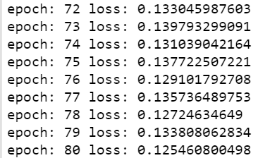

Forecasting
Unsupervised Deep learning model --
Autoencoder
Train loss:
Test loss and accuracy
smaller than XGBoost

Slide 19
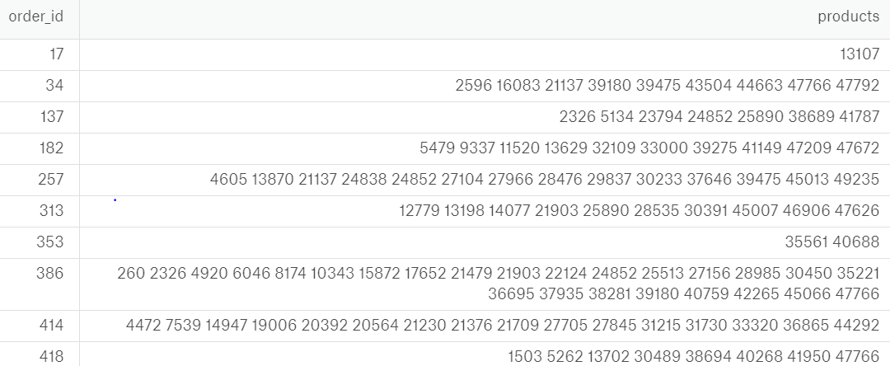
Forecasting
Unsupervised Deep learning model --
Autoencoder
Products prediction
in next order

Slide 20
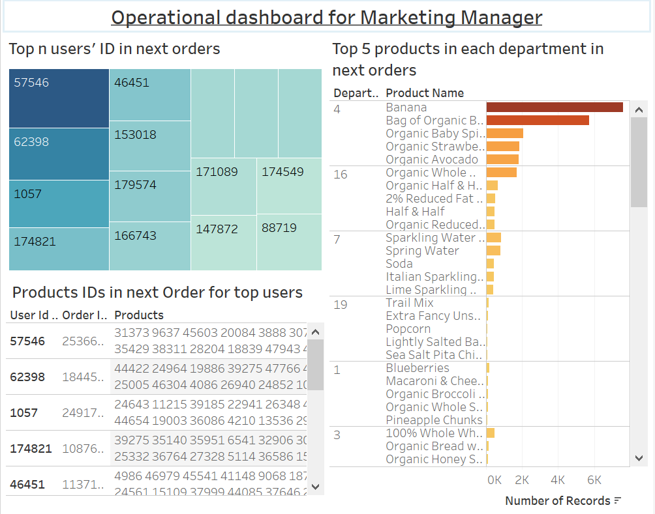

Slide 21
Summary and Conclusion
Regional dashboard: monitor KPI in each city/state, focus on more profitable customers, give them priority and delivery fee discount.
Delivery time dashboard: reduce delivery time.
Recommendation System: to personalize advertisement, service and arrange delivery in advance.

Slide 22
Thank you
Questions?

